Slide 1
Reducing memory usage

Slide 3
Ma’lumotlar to’plamini
ajratish

Slide 4
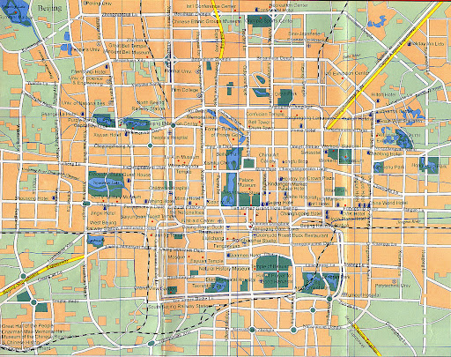
Overfitting:
haddan tashqari moslashish
Model o’ta kompleks,
ammo, input undan ancha oddiy

Slide 5

Underfitting:
noto’g’ri moslashish
Model o’ta oddiy,
ammo, input undan ancha murakkab

Slide 6
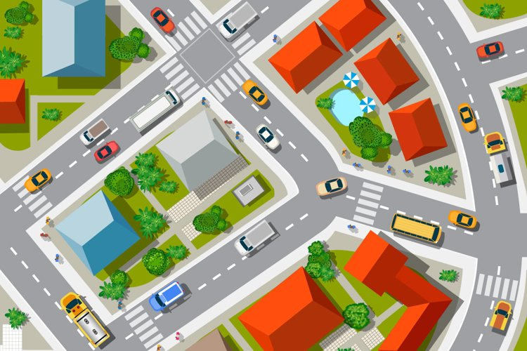

Slide 7
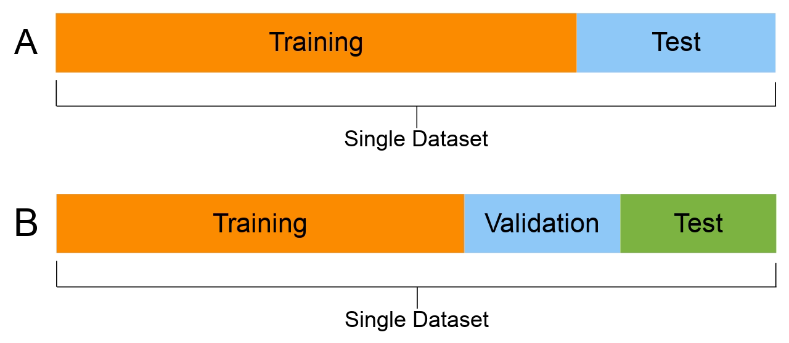
Dataset = Training set + Test set

Slide 8
Validation set:

Slide 9
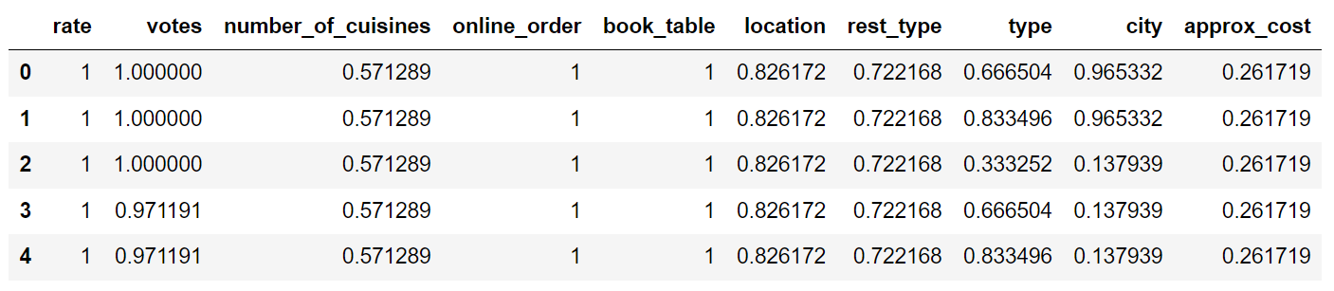
X
y
100%

Slide 10
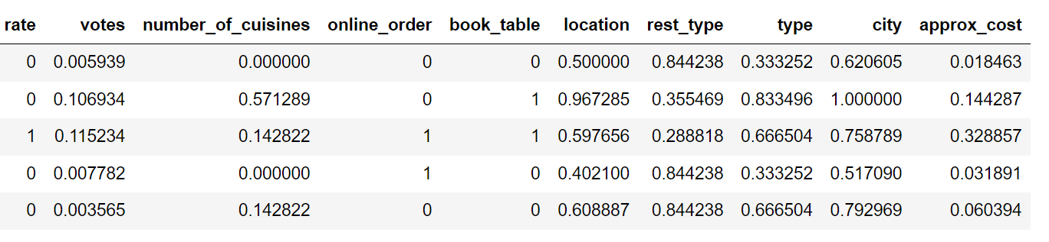
X_train
y_train
Train set
70%
X_test
y_test
Test
set
30%

Slide 11
Training

Slide 12
Training:
tayyorlangan ma’lumotlarni ma’lum algoritm asosida o’qitish
Vazifamiz:
narxni bashorat qilish
Modelimiz:
bashorat qiluvchi model (predictive)
Machine Learning algoritmlar:
Linear Regression, Decision Tree, Random Forest, SVM, k-NN

Slide 13
Evaluation

Slide 14
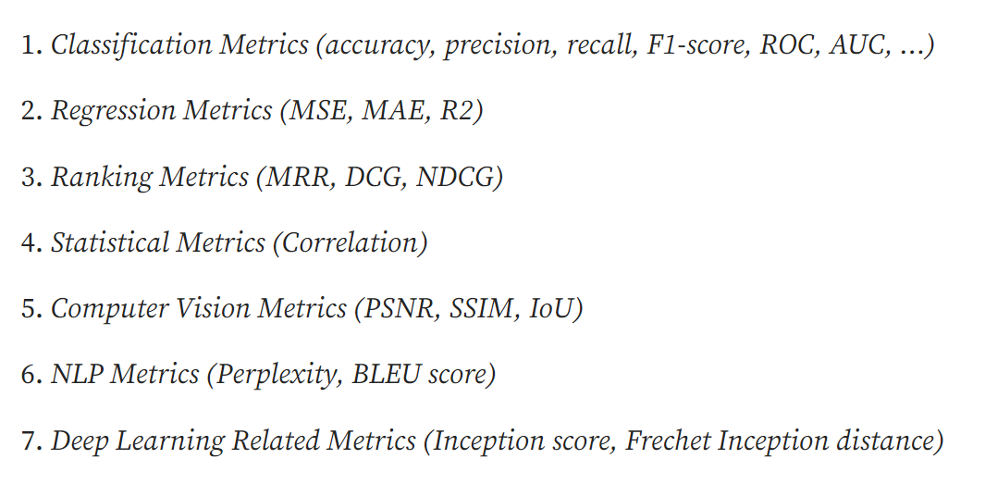
Evaluation:
modelni baholash

Slide 15
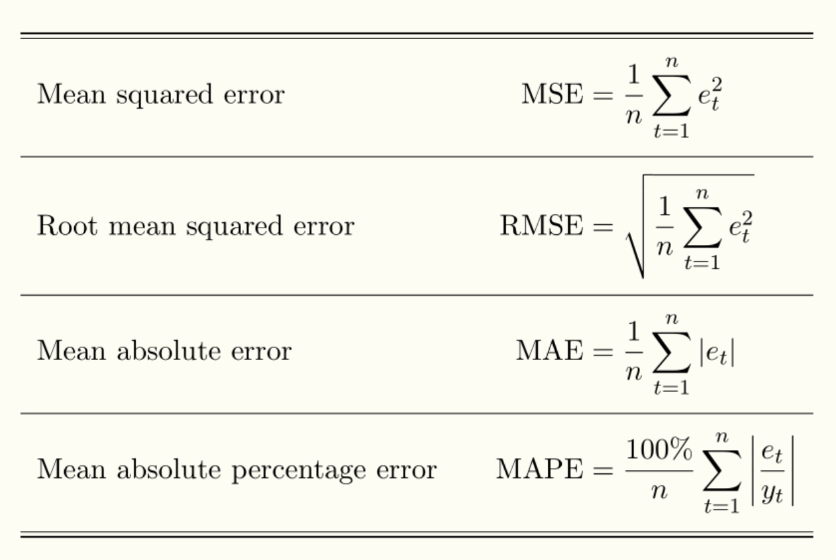
Regression metrics:
regressiya o’lchovlari

Slide 16
Hyperparameter
tuning

